Slide 1
Welcome
James Staniforth
Principal and CEO

Slide 2
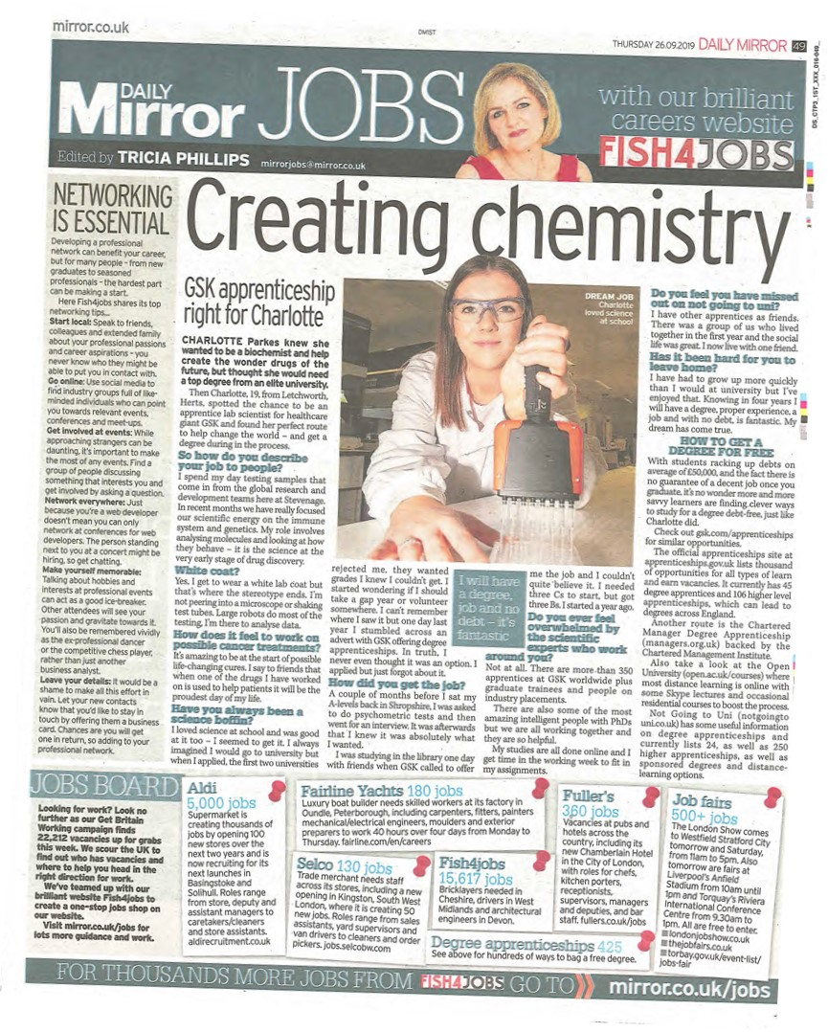
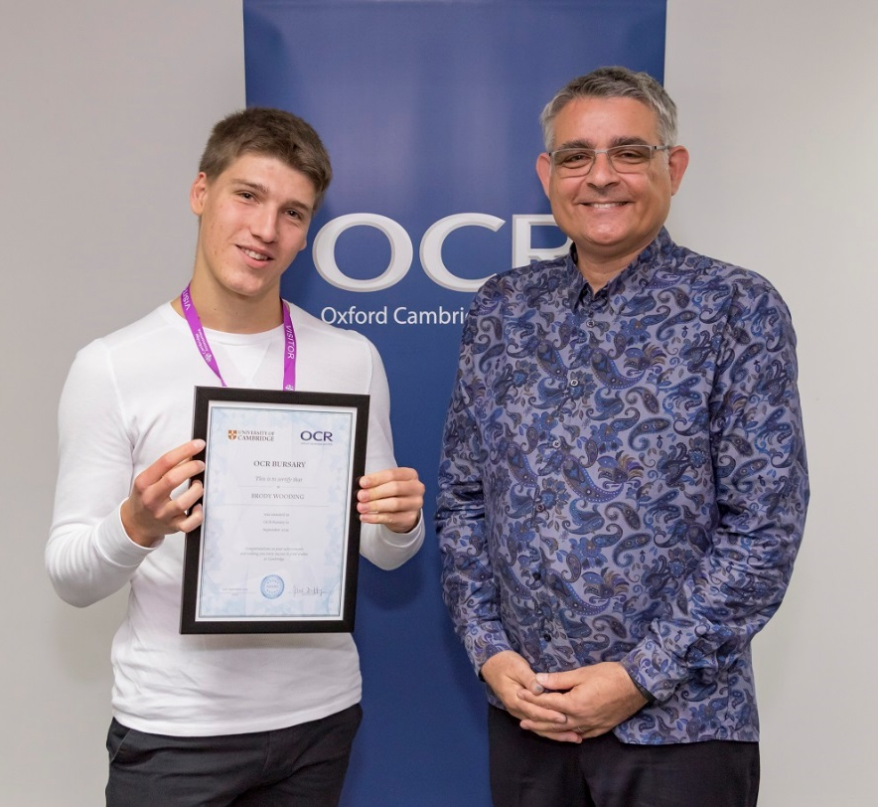
Outstanding Futures: Academic and Vocational Excellence … one week in Shropshire!

Slide 3
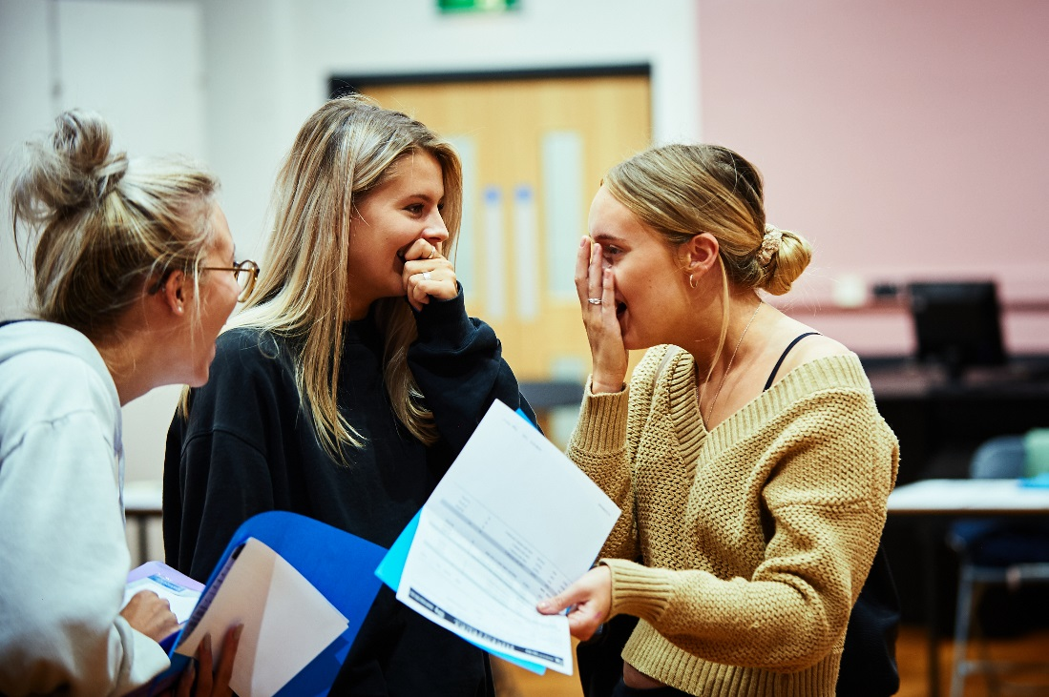
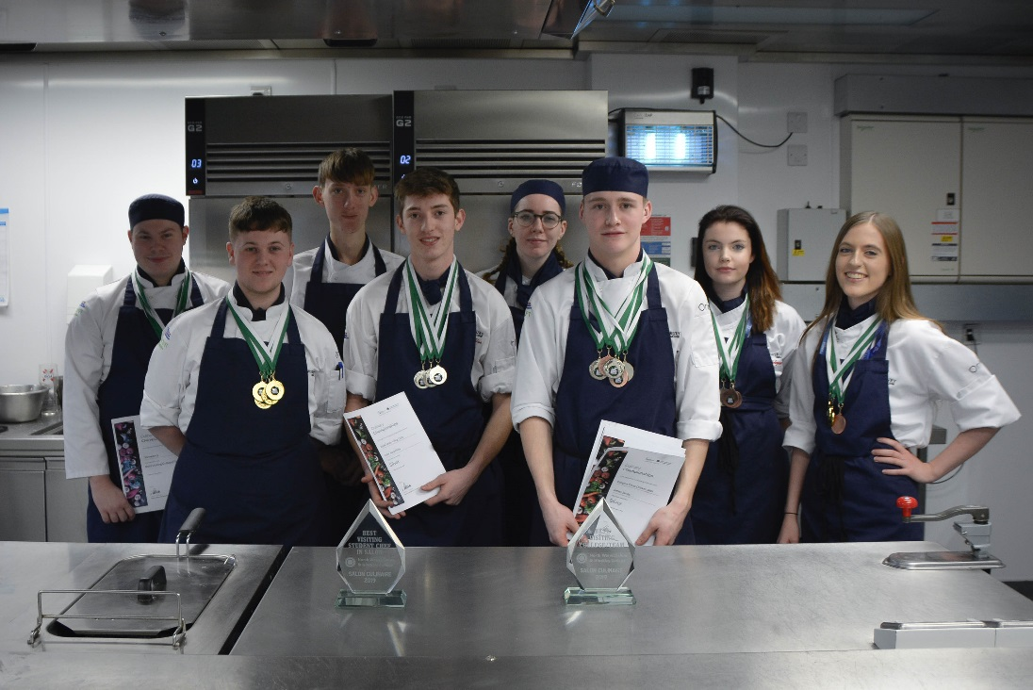
Outstanding Futures: Academic and Vocational Excellence

Slide 4
Where Our Students Go...

Slide 5
Where Our Students Go...

Slide 6
Studying Post 16
A Level or
Vocational Course
Personal Tutorial
Enrichment
GCSE/Functional Skills
English and/or Maths

Slide 7
Making the right choice
Academic route
University or professional job
Vocational route
University, job or apprenticeship
Technical route
Job or apprenticeship

Slide 8
Shrewsbury Colleges Group Prospectus

Slide 9
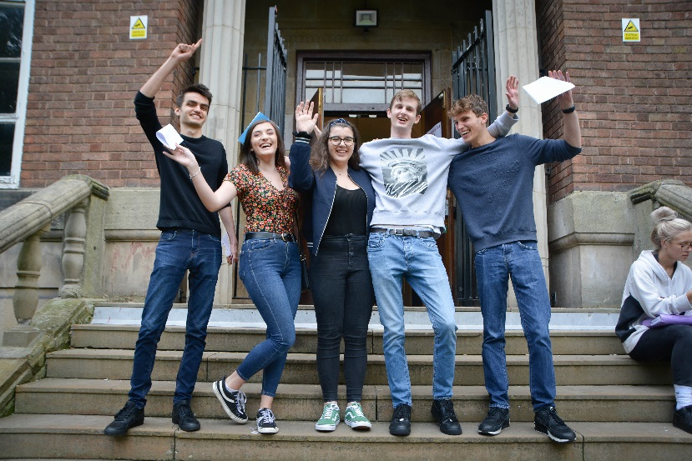
A Levels
Applied Science BTEC
Biology
Business
Chemistry
Classical Civilisation
Computer Science
Drama & Theatre Studies
Economics
Electronics
English Language
English Literature
English Language & Literature
Film Studies
Fine Art
French
Geography
Geology
German
Graphics
Health & Social Care BTEC
History
ICT BTEC
Law
Mathematics
Further Mathematics
Statistics
Media Studies
Music
Photography
Physical Education
Physics
Politics
Product Design
Psychology
Religious Studies
Sociology
Spanish
Textiles

Slide 10
BTEC Extended Diplomas
Art
Fashion
Photography
Creative Media
Music Technology
Performing Arts
Applied Science
Engineering
Business
Travel and Tourism
IT
Childcare
Health & Social Care
Construction
Sports Coaching and Fitness
Football
Rugby
Outdoor Pursuits
Public Services

Slide 11
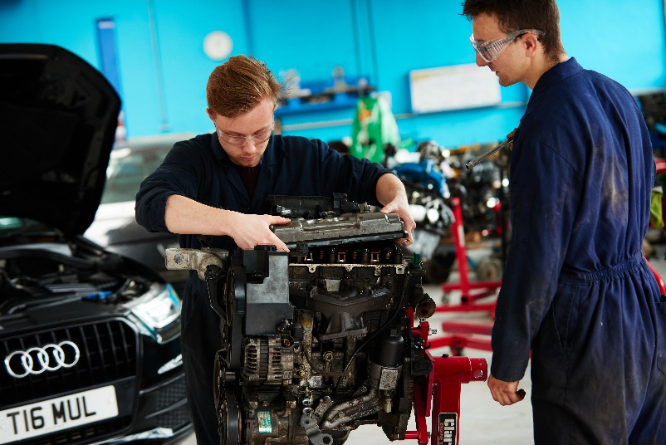
Technical and Professional Courses
Brickwork
Carpentry
Construction Trades
Electrical Installation
Plumbing
Painting & Decorating
Beauty
Hairdressing
Engineering
Motor Vehicle
Catering
Hospitality

Slide 12
You Have Choices… But what do they mean?
Catherine Armstrong
Vice Principal Curriculum Support & Development
Vocational Quals
Levels 1 to 4
Apprenticeships
continuing
English & Maths
Diplomas
Awards
A Levels
Certificates
UCAS points
Skills Based Learning

Slide 13
Things to consider…
What subjects
you enjoy
Your future career
Qualifications you need
Choice of Organisation

Slide 14
Making an Application
Your choice where you apply to
You can make multiple applications
Decisions made on achieving GCSE results
Have multiple applications in at SCG
*be aware of some A Level timetable restrictions

Slide 16
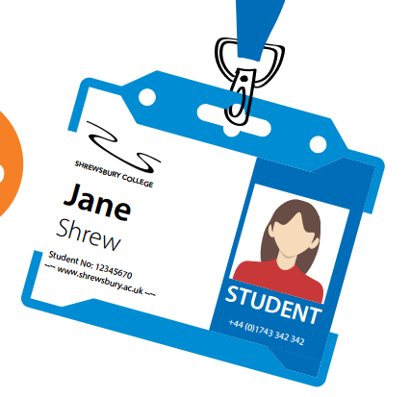
You need an employer and a contract
+
Earn while you Learn
+
Can’t find an employer?
Start on a Full-time course with us and transfer later.
Based in the workplace, possible day release to College
+
=
+
Apprenticeships provide the opportunity to train whilst employed, based on the subjects area and type of work will depend upon whether you train in the workplace or have day release attendance at college
To be an apprentice you have to have an employer with a contract of employment
If you haven't got an employer but want to be an apprentice- full time study allows you to be recommended by staff to employers and transfer to an apprenticeship in year or as your next level for progression.
Apprenticeship vacancies are advertised on NAS in the press and on company websites

Slide 17
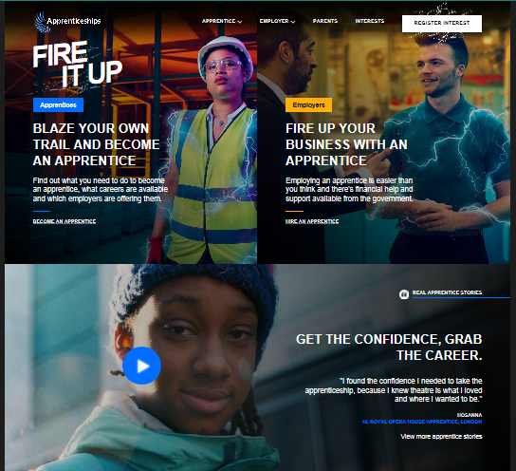
Search ‘Apprentices gov.uk’ to find apprenticeship opportunities
Search by location and job type to get the Apprenticeship that’s right for you.

Slide 18
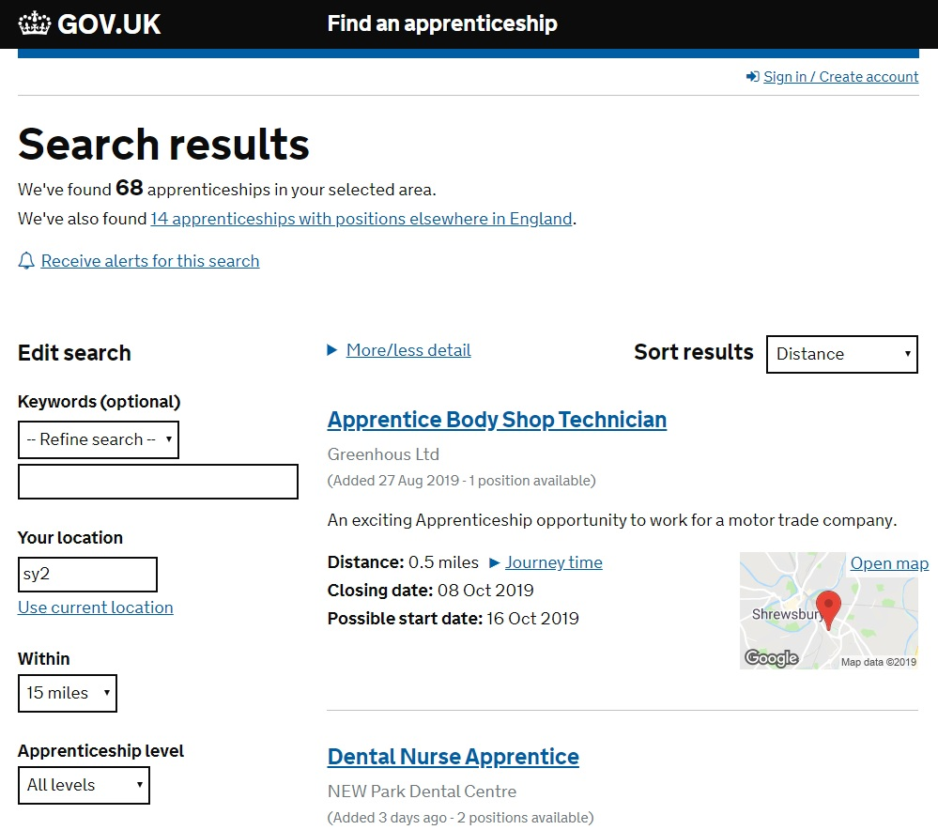
Search by location and job type to get the Apprenticeship that’s right for you …
68 Apprenticeships within
15 miles of SY2
Hairdressing
Motor Vehicle
Warehouse
Dental Nurse
Optical Assistant
Business Admin
Engineering
Network Rail
Pharmacy
Customer Service

Slide 19
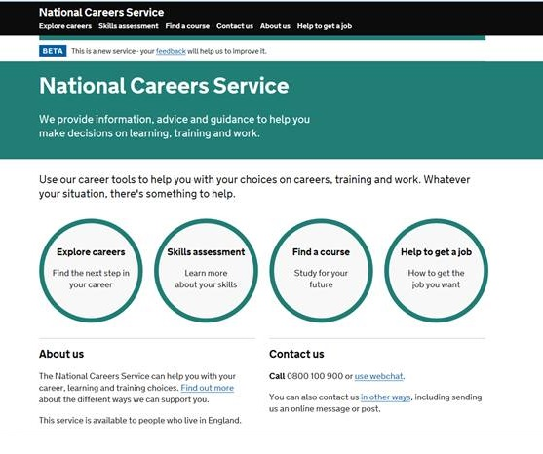

Slide 20
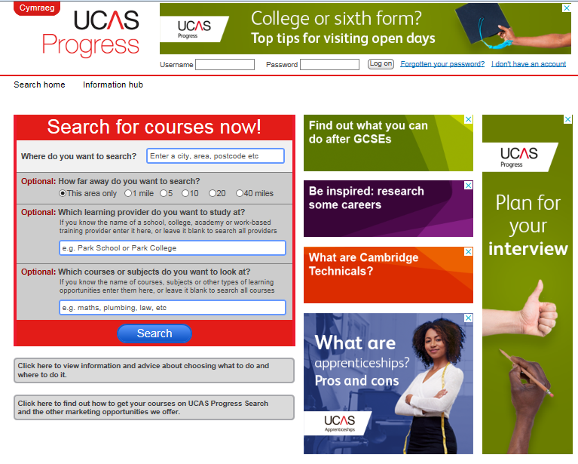
Not just for University applications
UCAS Progress can help you find the right qualification for the career you want.

Slide 21
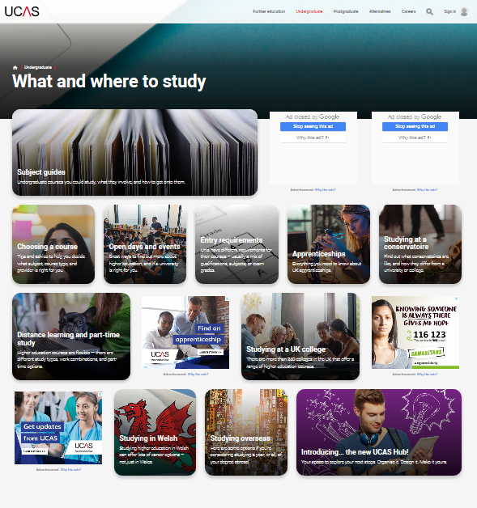
Then use the undergraduate UCAS website to find out the range of degree courses and their individual entry requirements.

Slide 22
Make the right choice of where to study …
Found it?
Apply on line
Attend an interview
Pre Induction/Welcome Events
Enrolment
Induction
Attend tasters
Work experience
Research University entry
Apprenticeships
Attend open events

Slide 23
We wish you all the best in your studies this year and look forward to seeing you in the future.
☺

